Slide 1



CubeSat Reaction Wheel Attitude Control Platform 10/10 Meeting

Slide 2
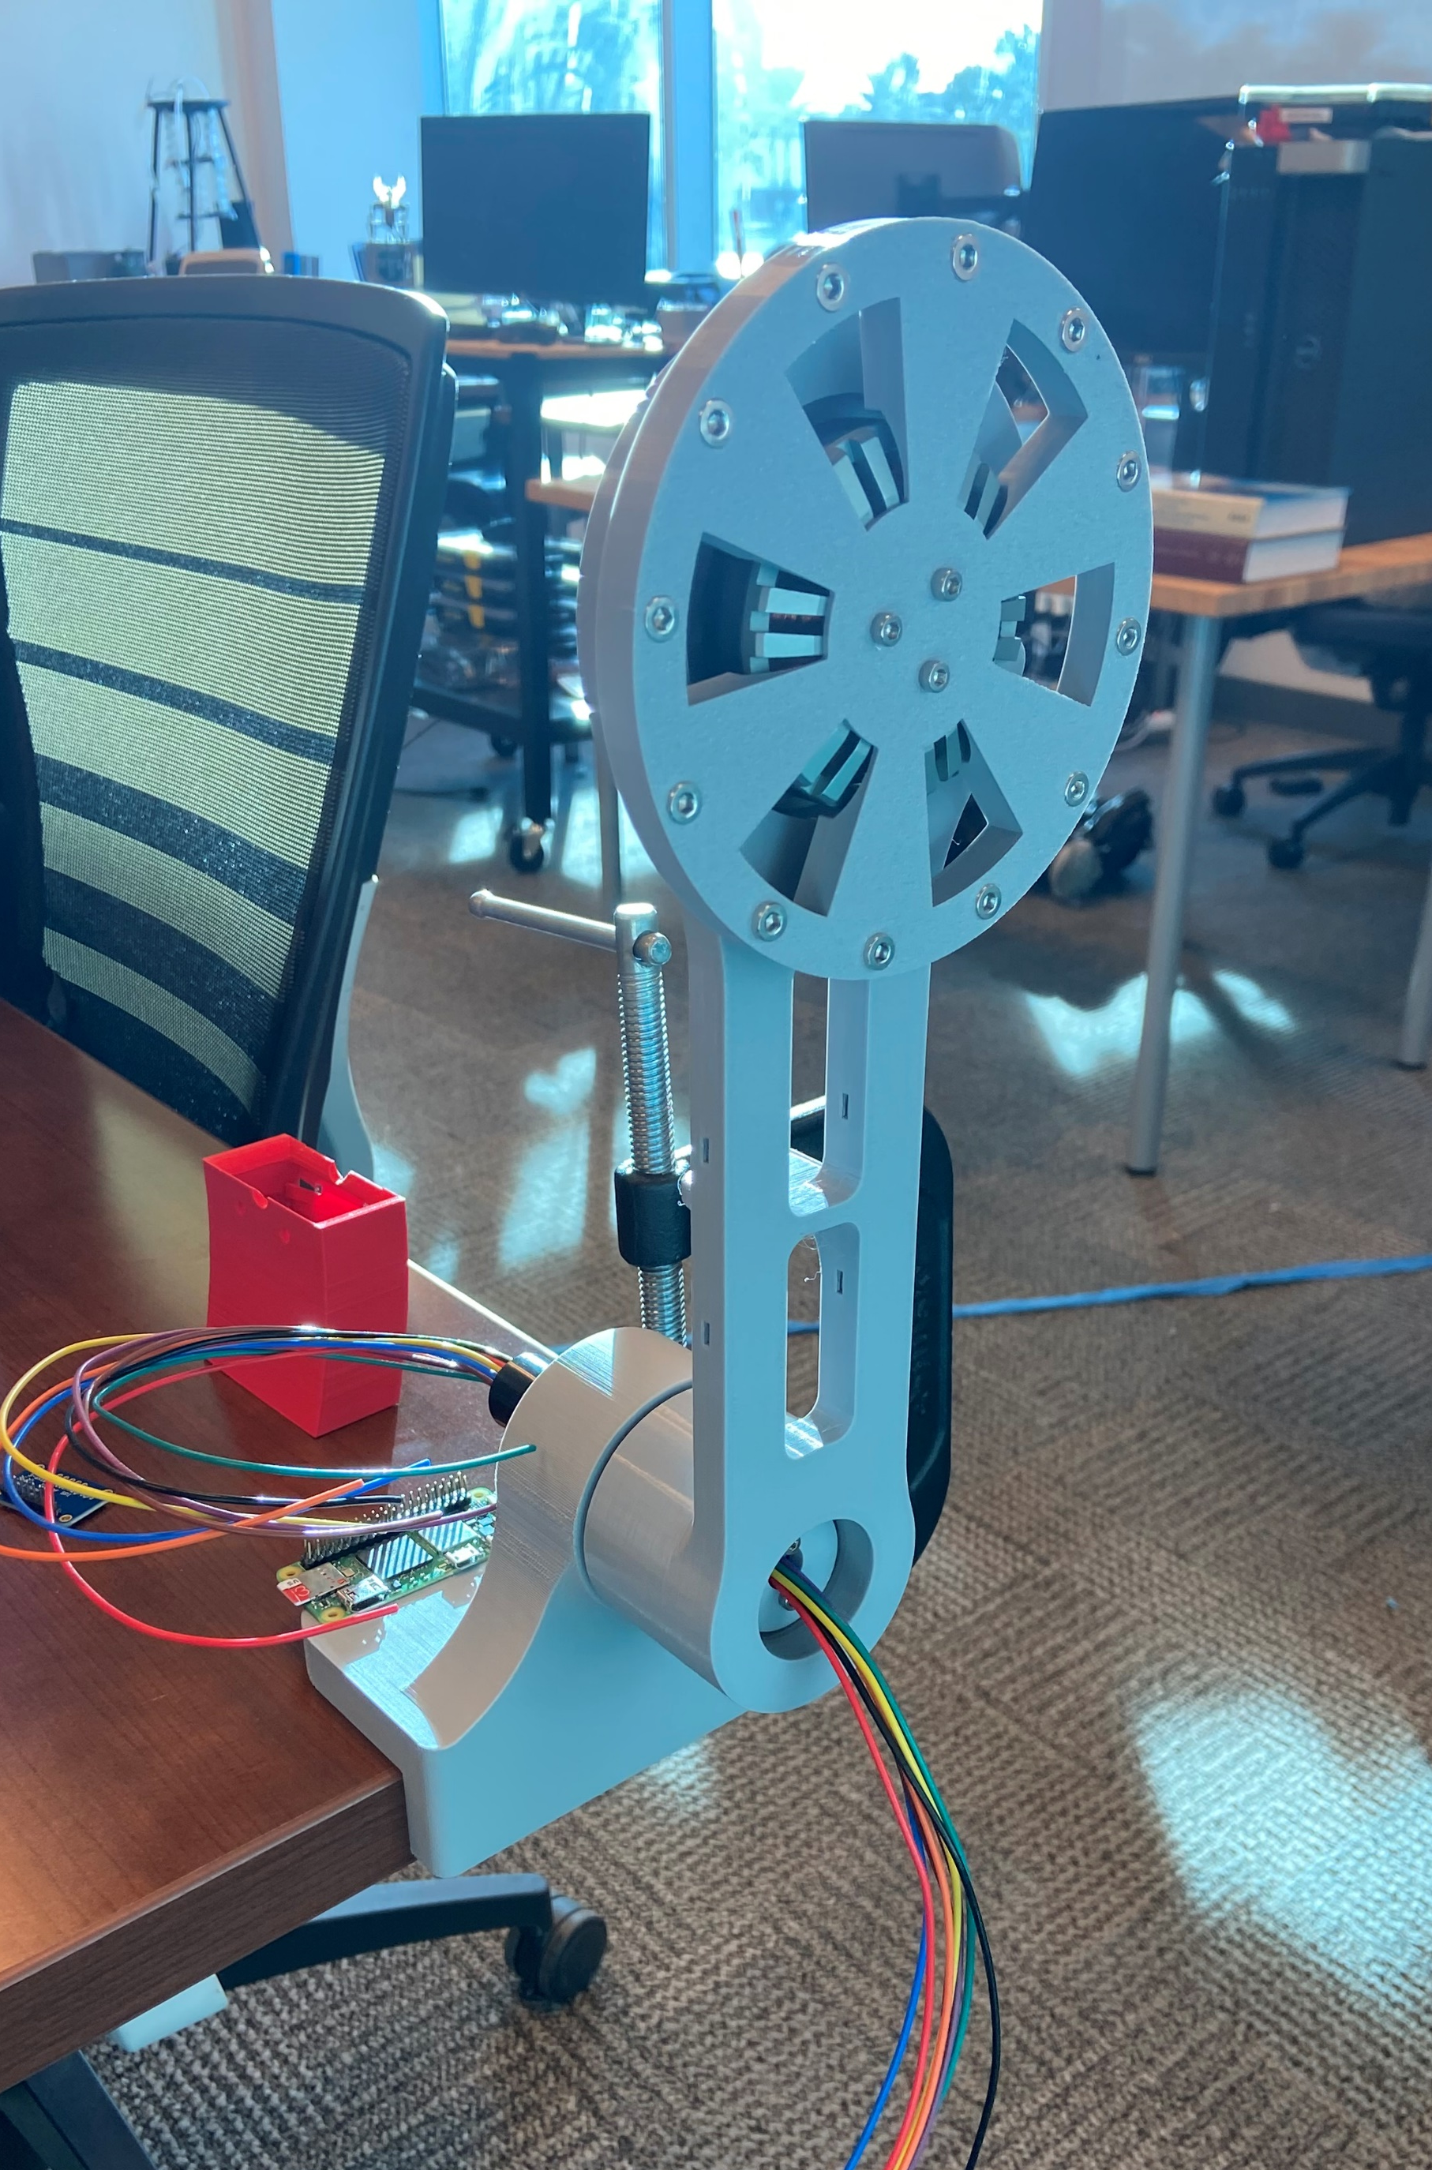
[Justin]:
Progress completed this week
Abstract submitted to SRS
Inverted pendulum hardware printed and assembled [90%]
ACTIV general priorities outlined [<50%]
Goals for next week
Make timeline for ACTIV
Wire up inverted pendulum now that 8 wire slip ring has arrived
Feed IMU data in SQLite database
Anticipated Challenges
Notes:
Duplicate slide and fill in relevant information

Slide 3
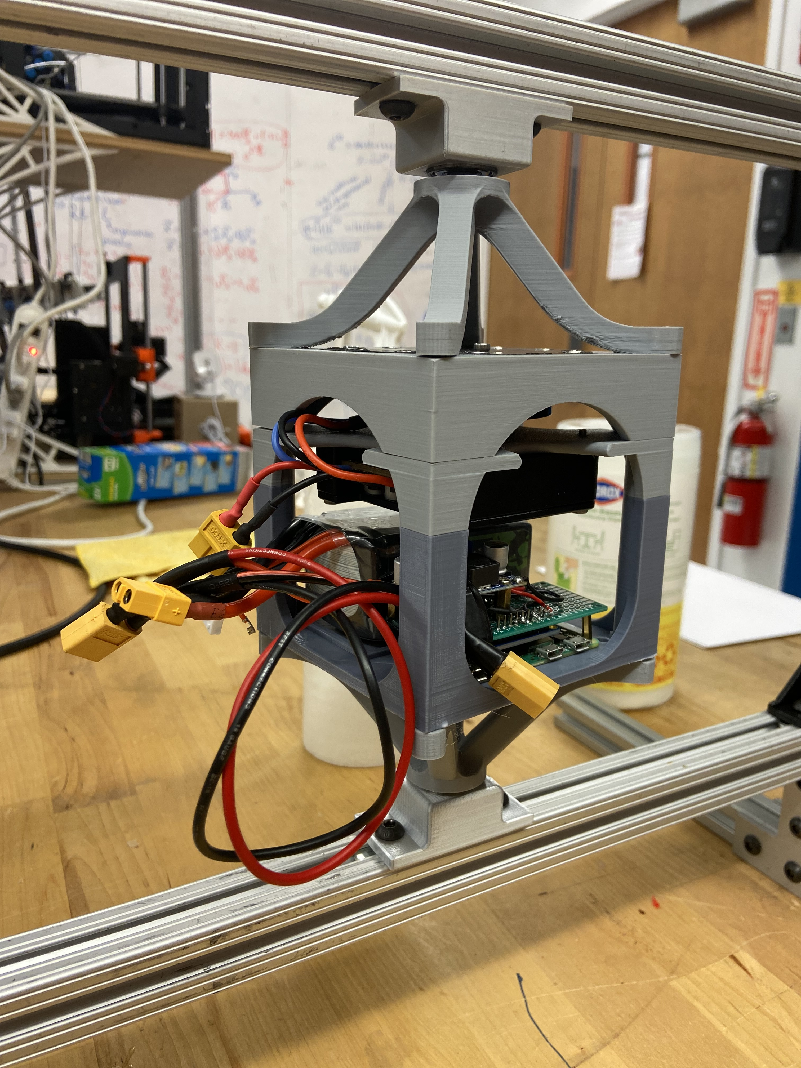
[Ella] Bottom Claw & Cube Config.
Progress completed this past week
-Print the new design and add it to the whole system
-Change threaded insert hole diameter
-Design new claw system for bottom cube configuration
-Highlight based on: Complete
Goals for next week
-N/A
Anticipated challenges
-Threaded insert holes are too big. Need to order different thickness
Notes:
Duplicate slide and fill in relevant information

Slide 4
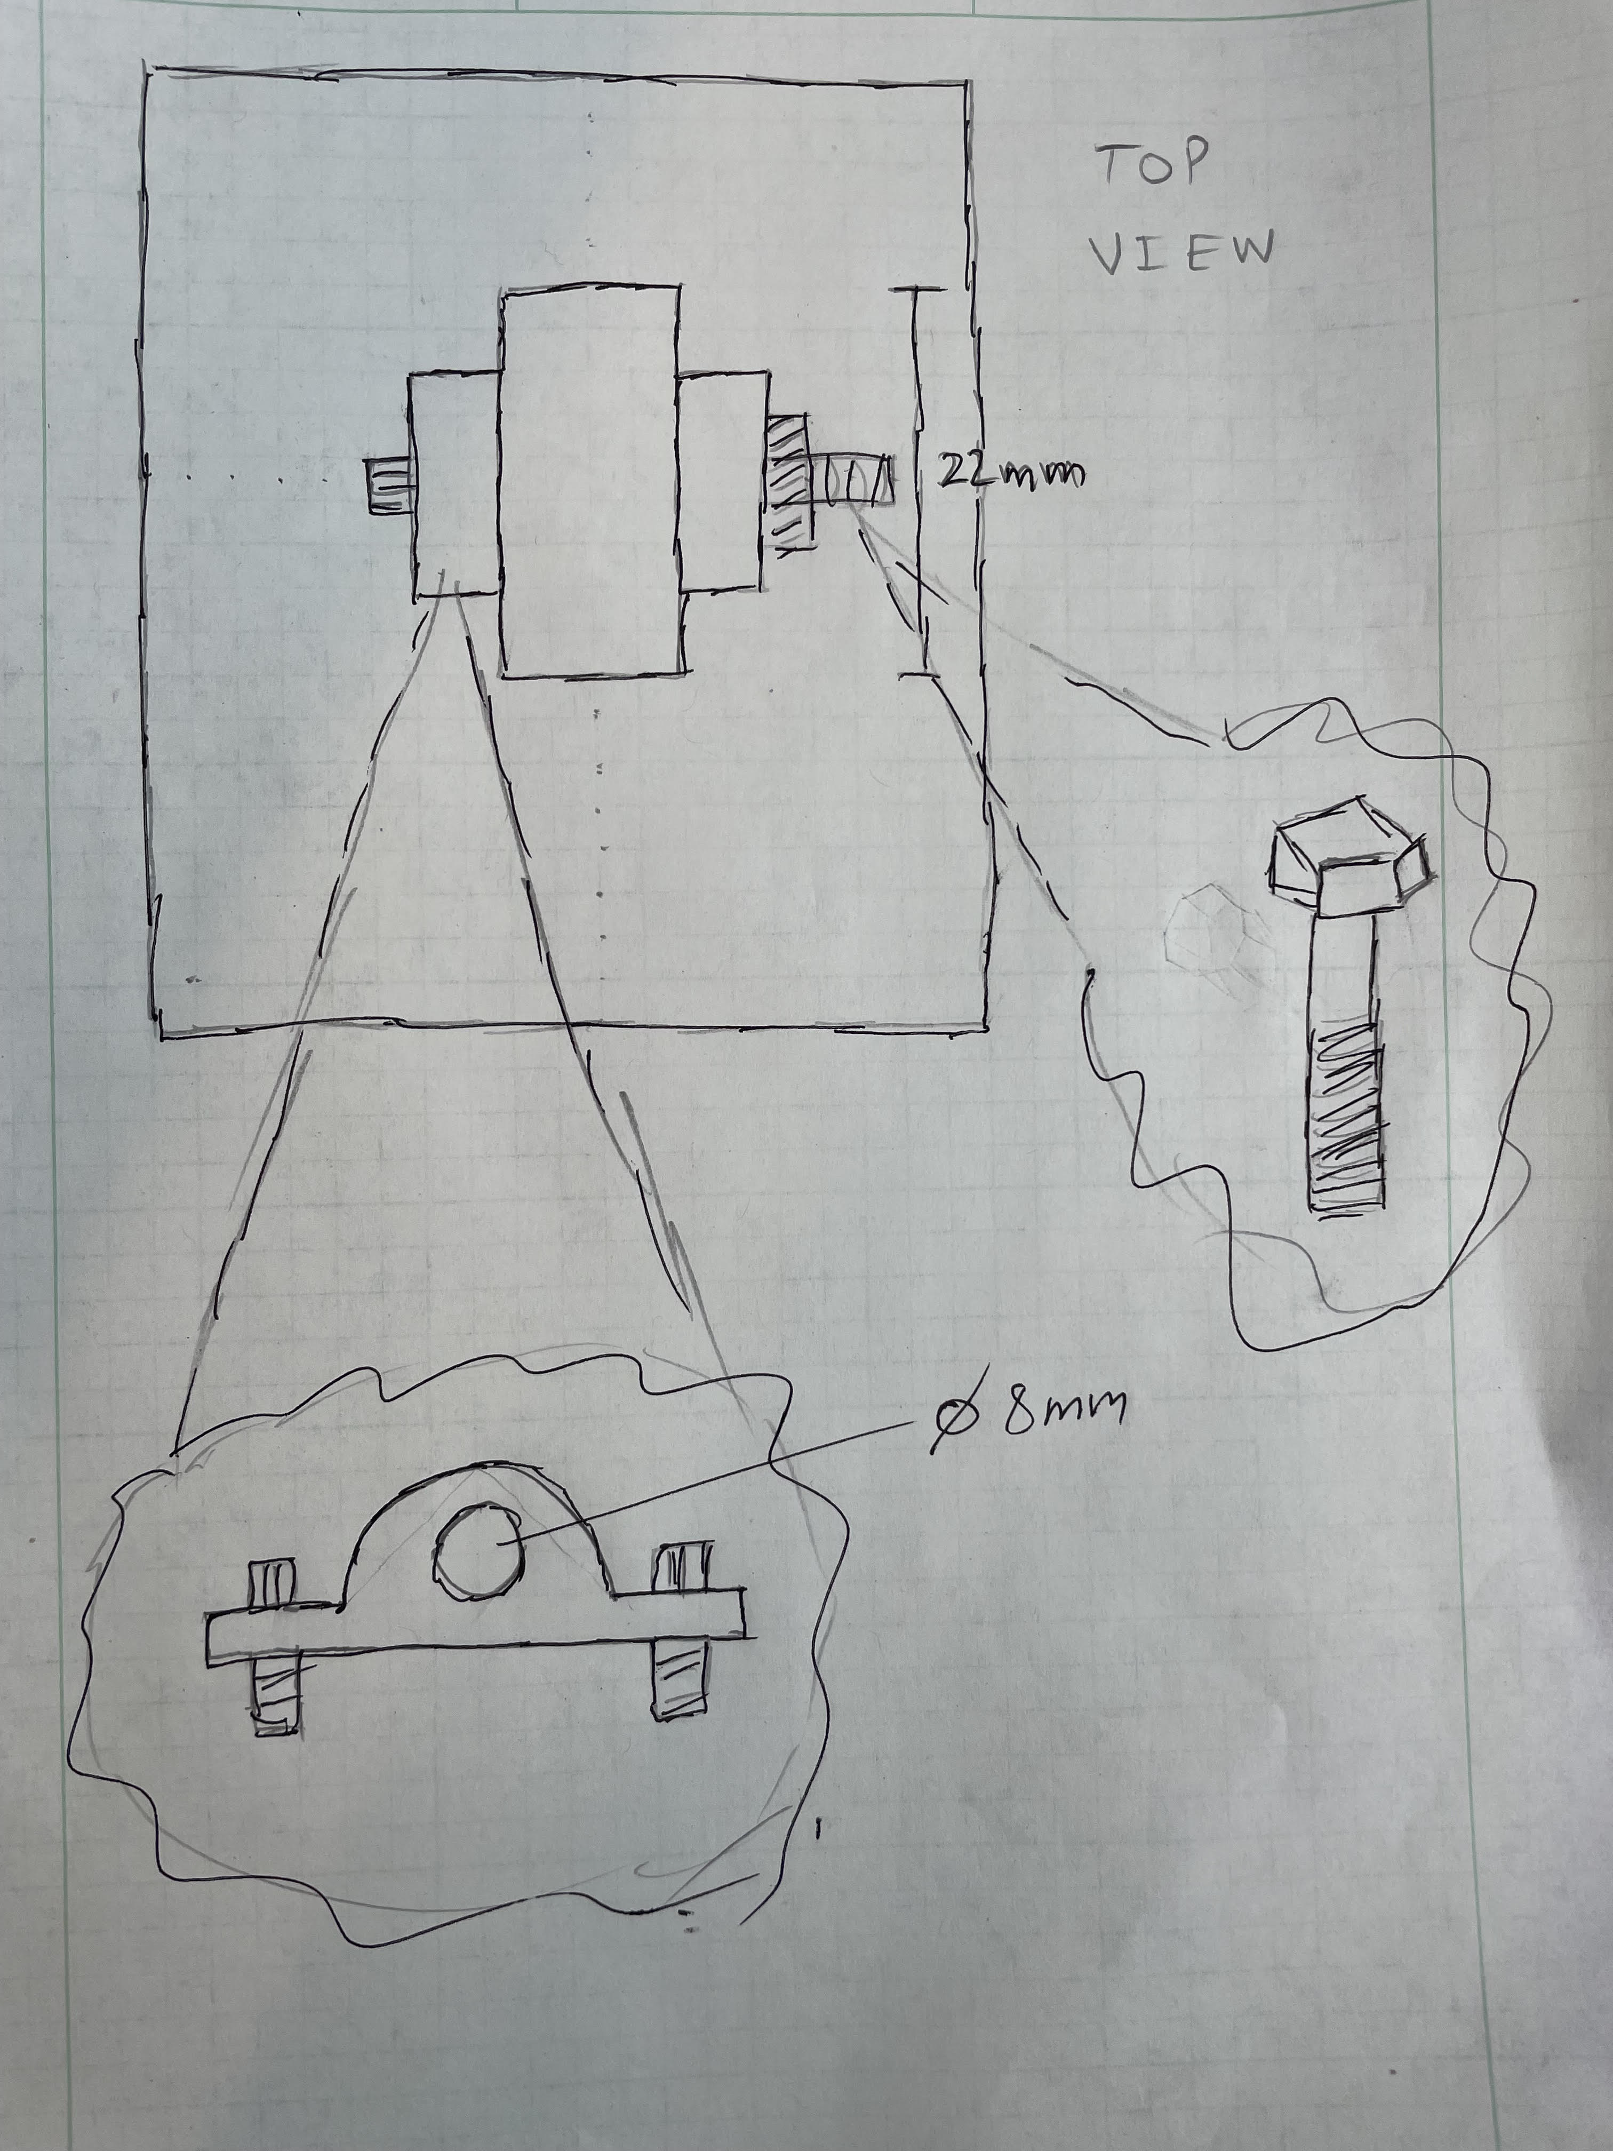
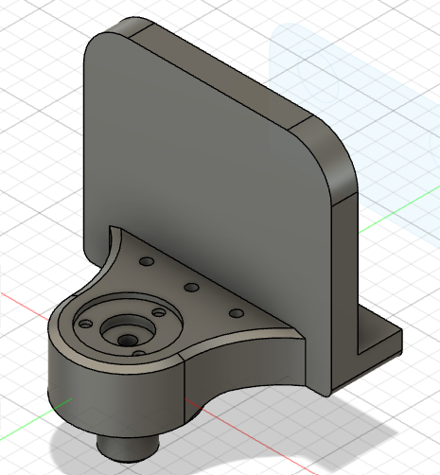

[Vishal] New Inverted Pendulum
Progress completed this past week
360 pendulum base complete
-Highlight based on: 100%
Goals for next week
Determine upcoming tasks
Anticipated challenges
4

Slide 5
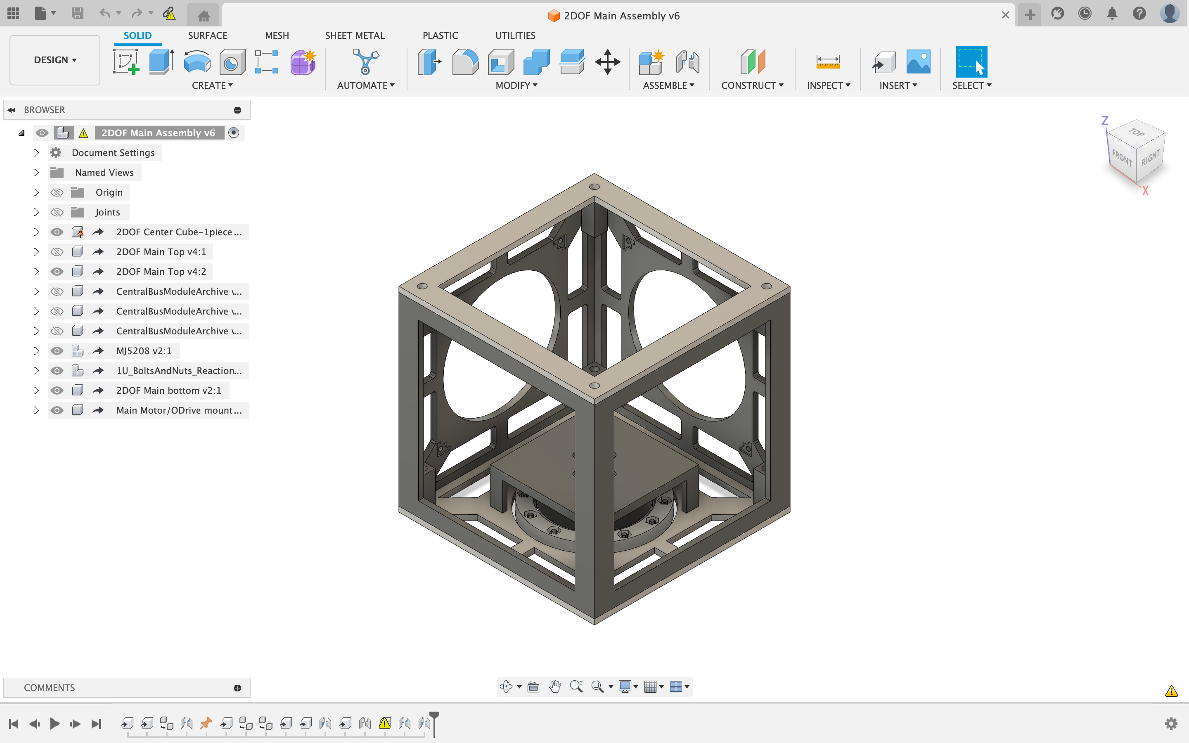
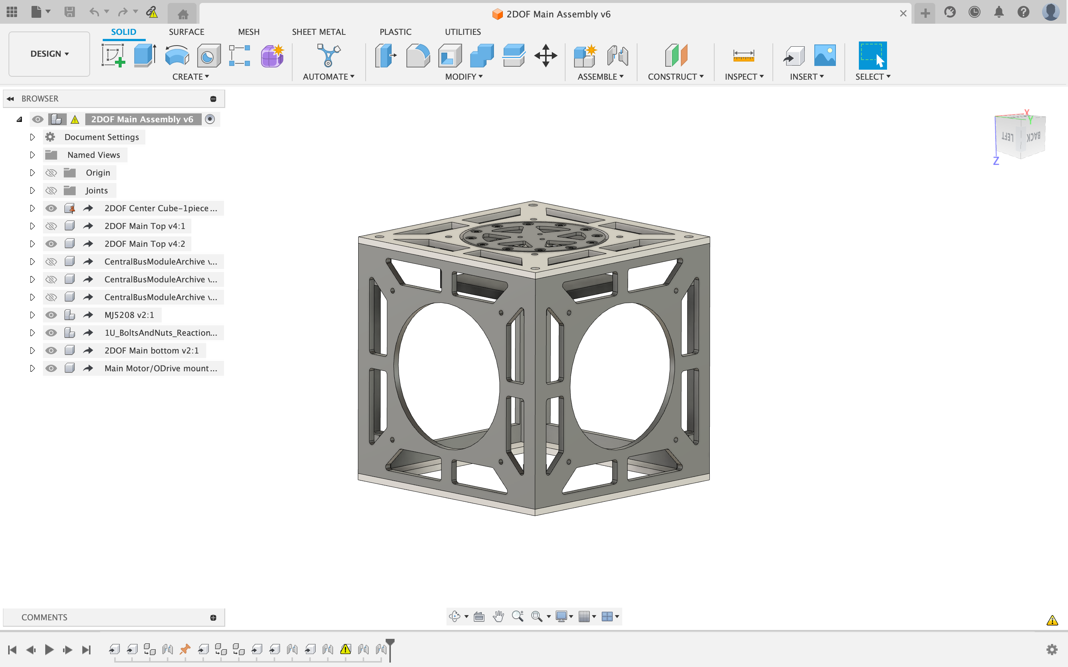
[Isaac] Daisy Chaining O-Drives
Progress completed this past week
-Fixed height of pizza table
-Fixed openings on cubeSat sides for ease of use
-Partially made new pizza table to fit 3 inside
cubesat
Goals for next week
-Finish pizza table
-Fix the mounts for three main cubesat body for new pizza table
Anticipated challenges
-iterations to fit all into the smallest space

Slide 6
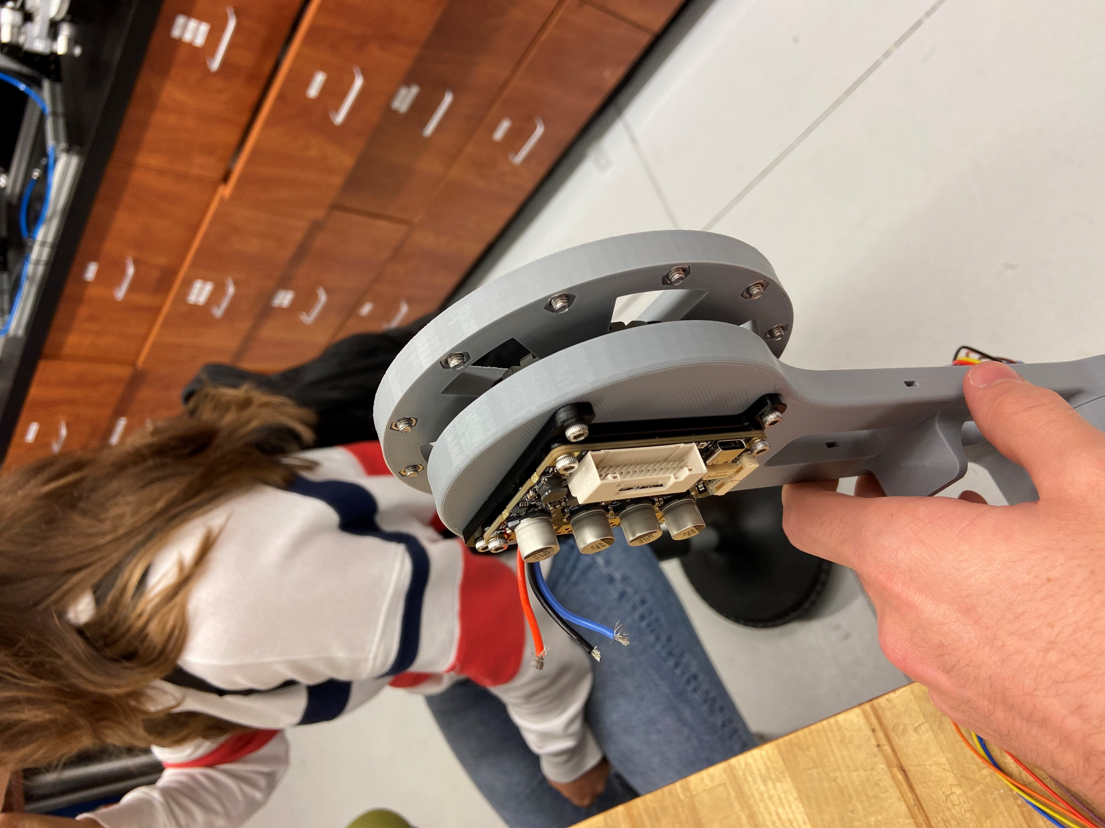
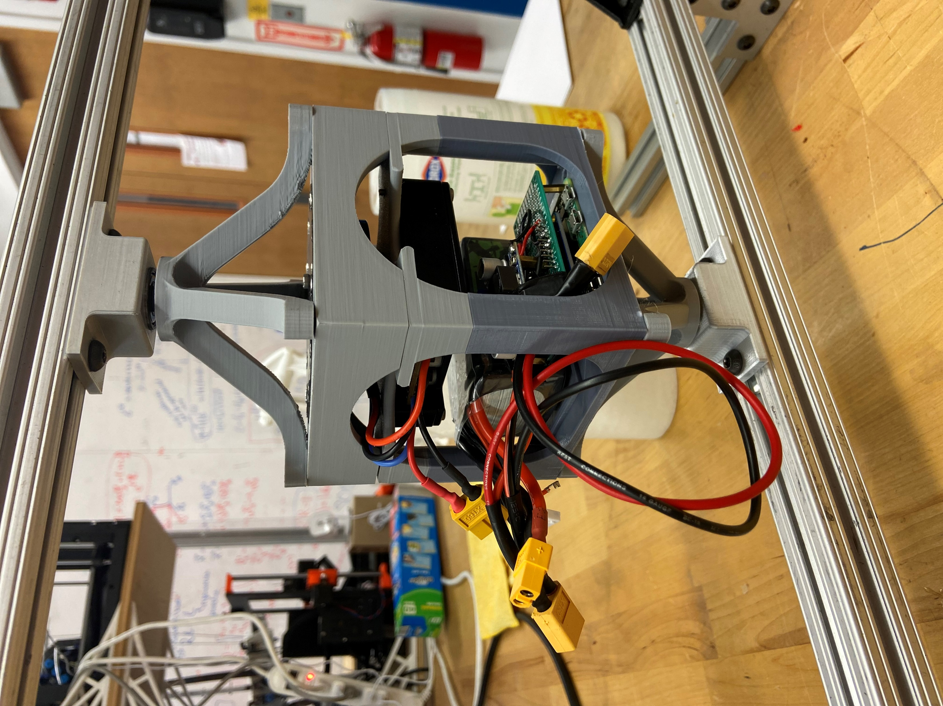
Visual System Updates
Notes:
Duplicate slide and fill in relevant information

Slide 7

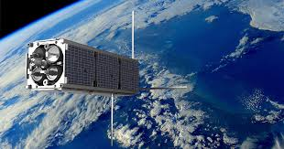
[Assignee] + [Task Title]
Progress completed this past week
-[Discuss progress]
-Highlight based on: Complete, >50%, <50%
Goals for next week
-[Discuss goals]
Anticipated challenges
-[discuss challenges, request assistance if needed]
[Relevant photos if needed]
COPY
Notes:
Duplicate slide and fill in relevant information

